Slide 1


Data Management

Slide 2
Recap of Week 1
Official (Open)
What is Data Management?
Database Management Systems
Data Lake vs Data Warehouse
Data Discovery
Data Cleaning (Accurate data, valid data)
Data Integration
Data Labelling
Data Lineage
Notes:
Understand the concept

Slide 3
Week 2 Topics
Official (Open)
Pandas
Installation and import
Series and DataFrames
How to read in data
Important DataFrame Operations
Plotting
Practical – Hands On Pandas

Slide 4
What’s Pandas for?
Official (Open)
Through pandas, you get to know your data by cleaning, transforming, and analyzing it.
For example, you want to explore a dataset stored in a CSV. Pandas will extract the data from that CSV into a DataFrame — then let you do things like:
Calculate statistics like Average, Median, Max, Min etc (all sorts of mathematical operations)
Clean the data by doing things like removing missing values and filtering rows/ columns
Visualize the data with help from Matplotlib. Plot bars, lines, histograms, bubbles etc
Store the cleaned, transformed data back into a CSV, other file or database

Slide 5
Installation & Import
Official (Open)
Launch a terminal program (for Mac users) or command line (for PC users) and install it using command:
pip install pandas
To import pandas, we use
import pandas as pd

Slide 6
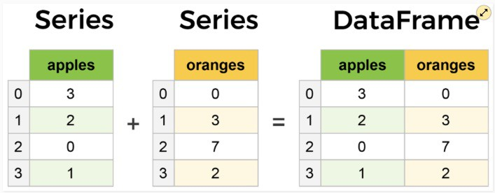
Core components of pandas: Series and DataFrames
Official (Open)
The primary two components of pandas are the Series and DataFrame.
A Series is essentially a column, and a DataFrame is a multi-dimensional table made up of a collection of Series.
Notes:
More than 1 column -> dataframe

Slide 7
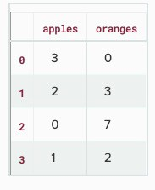
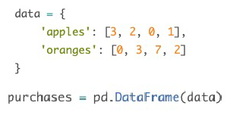
Official (Open)
Creating DataFrames from scratch
Let's say we have a fruit stand that sells apples and oranges. We want to have a column for each fruit and a row for each customer purchase. To organize this as a dictionary for pandas we could do something like:
Notes:
Import pandas as “pd”.
Declare a variable called “data” to store as dictionary.
Declare a variable called “purchases”
DataFrame is a multi-dimensional table made up of a collection of Series.
So, pd.DataFrame(data) -> this will show the output of the data in a table form.

Slide 8
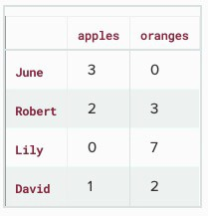
Official (Open)
Index
The Index of this DataFrame was given to us on creation as the numbers 0-3, but we could also create our own when we initialize the DataFrame.
Notes:
Transactions Record Table
Create an “index” after ”data” with a comma.
In the ”index”, create a dictionary of the string/values that you want to replace the default values. (For E.g., 0 to June)

Slide 9
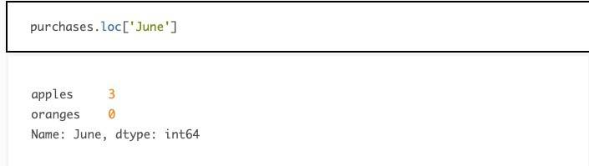
Official (Open)
Index
So now we could locate a customer's order by using their name:
Notes:
Locate the customer’s order using their name
Unique, only can use one index

Slide 10

How to read in data?
Official (Open)
With CSV files all you need is a single line to load in the data:
If you need to set the index column, you could use index_col. For example:
1st column data
Notes:
Read_csv(“ ”) -> locate excel file to read the data
Index_col = 0 (if you want to use the first column data)

Slide 11


How to read in data?
Official (Open)
If you have a JSON file — which is essentially a stored Python dict — pandas can read this just as easily:
We can also read data from a SQL database, by first establishing a connection, then pass a query to pandas:
Notes:
Read json from the file name
Need import sqlite3 if you want to use sql

Slide 12
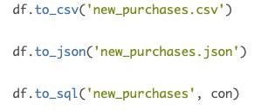

How to save into file?
Official (Open)
Notes:
To save the file

Slide 13
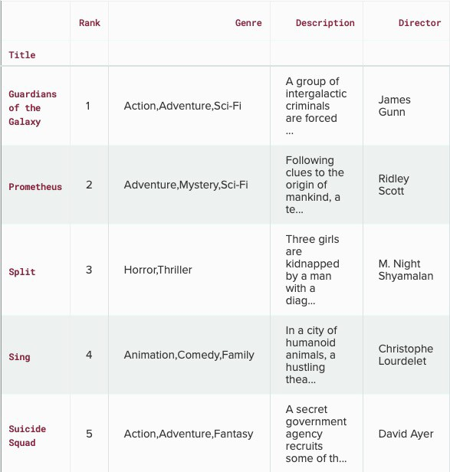

Viewing your data
Official (Open)
The first thing to do when opening a new dataset is print out a few rows to keep as a visual reference. We accomplish this with .head():
movies_df.head(10)
Notes:
.head() -> used for viewing the FIRST 5 ROWS
.head(10) -> used for viewing the FIRST 10 ROWS

Slide 14
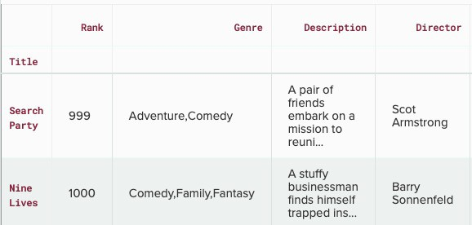

Viewing your data
Official (Open)
To see the last five rows use .tail( ). tail( ) also accepts a number,
and in this case we printing the bottom two rows.:
Notes:
.tail() -> used for viewing LAST 5 ROWS of the data
.tail(2) -> used for viewing the LAST 2 ROWS of the data
Declare a number inside the bracket to show how many rows from the bottom you want to see
Why movies? Cus you declared movies as a variable for the DataFrame of your data -> movies = pd.DataFrame(data)

Slide 15
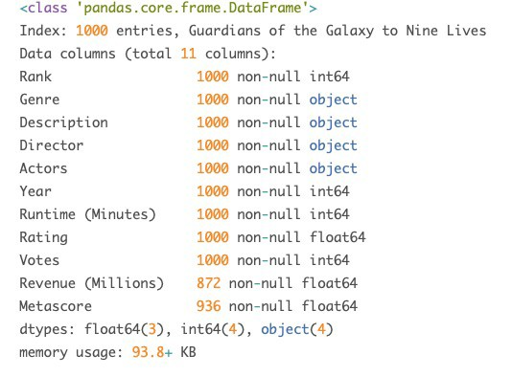

Getting info about your data
Official (Open)
.info( ) should be one of the very first commands you run after loading your data:
Missing values!
Notes:
1000 entries (rows)
Int, float, object – data types for each row
Must identify which data type the variable is from

Slide 16


Getting info about your data
Official (Open)
Another fast and useful attribute is .shape, which outputs just a tuple of (rows, columns):
Command: Output:
0
1
So we have 1000 rows and 11 columns in our movies DataFrame.
Notes:
To get the info on how many rows and columns your data had

Slide 17


Dropping duplicates
Official (Open)
Command:
Overwrite the data
Instead of keep assigning DataFrame to the same variable, we can use inplace=True
to modify the DataFrame object in place.
Does not overwrite the data

Slide 18
Dropping duplicates
Official (Open)
Another important argument for drop_duplicates is keep, which has three possible options:
first: (default) Drop duplicates except for the first occurrence
last: Drop duplicates except for the last occurrence
False: Drop all duplicates
Notes:
inplace = True (to overwrite)

Slide 19

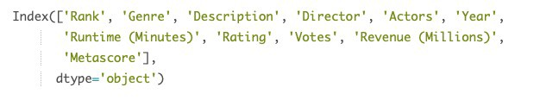
Dealing with columns
Official (Open)
Here’s how to print the column names of a dataset: Command:
Output:
Notes:
Print column names

Slide 20
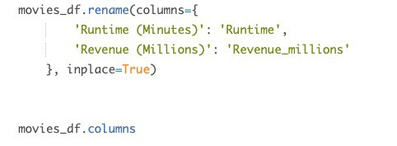

Renaming columns
Official (Open)
Command:
Output:
Notes:
You need to declare a dictionary for the values that you want to rename as

Slide 21
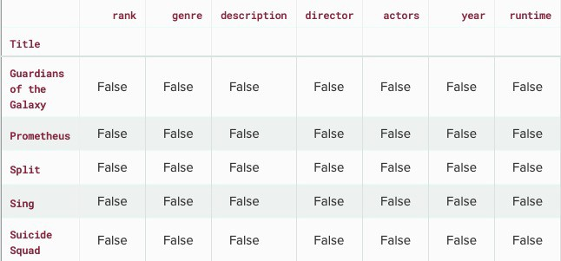

Handling missing values
Official (Open)
When exploring data, you’ll most likely encounter missing or null values. Most commonly you'll see Python's None or NumPy's np.nan.
To check which cells in our DataFrame are null: Command: Output:
isnull( ) returns true = missing isnull( ) returns false = existent
Notes:
To check which data is missing
For example, movies_df.isnull(true) -> there is smth missing
movies_df.isnull(false) -> there is smth inside

Slide 22
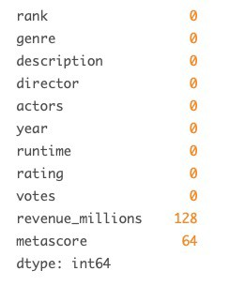

Aggregrate Function (sum)
Official (Open)
Command:
Output:
We can see now that our data has 128 missing values for revenue_millions and 64 missing values for metascore.
Notes:
To find the sum of the missing data there is for each column

Slide 23


Aggregrate Function [mean, median]
Official (Open)
Pandas uses the mean() and median() method to calculate the respective values for a specified column:
Notes:
Df = dataframe
Declare x and from the df, find the mean/median of the “calories” column

Slide 24

Removing null values
Official (Open)
Removing null data is only suggested if you have a small amount of missing data. Remove nulls is pretty simple:
This operation will delete any row with at least a single null value, but it will return a new DataFrame without altering the original one. You could specify inplace=True
in this method as well.
Notes:
To remove missing values

Slide 25

Removing null values
Official (Open)
Other than just dropping rows, you can also drop columns with null values by setting axis=1:
This operation would drop the
revenue_millions and metascore columns.
Notes:
axis=1?
Drop the missing data column

Slide 26

Imputation
Official (Open)
Imputation is a conventional feature engineering technique used to keep valuable data that have null values.
Instead of dropping every row with a null value, we can impute that null with another value, usually the mean or the median of that column.
First we'll extract that column into its own variable:
Using square brackets is the general way we select columns in a DataFrame.
Notes:
Put the data inside a variable

Slide 27

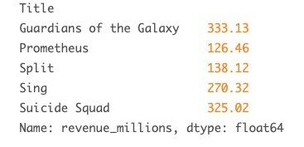
Imputation
Official (Open)
revenue now contains a Series: Command:
Output:
Notes:
To view ALL the revenue data

Slide 28
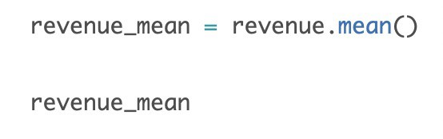
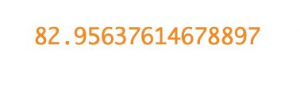

Imputation
Official (Open)
Now, we impute the missing values of revenue using the mean. Command: Output:
//print
We can fill the nulls using fillna( ) :
We have now replaced all nulls in revenue with the mean of the column.
Notes:
Fill the missing value
Revenue_mean -> 82

Slide 29
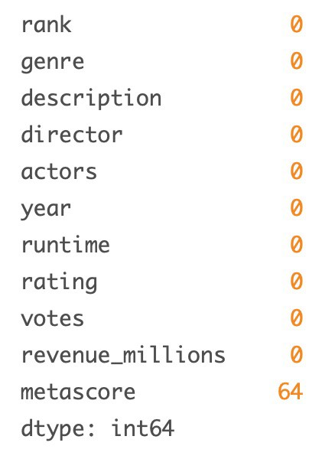

Imputation
Official (Open)
To confirm the changes has been reflected: Command:
Output:
Notes:
To find the sum of missing data there is

Slide 30
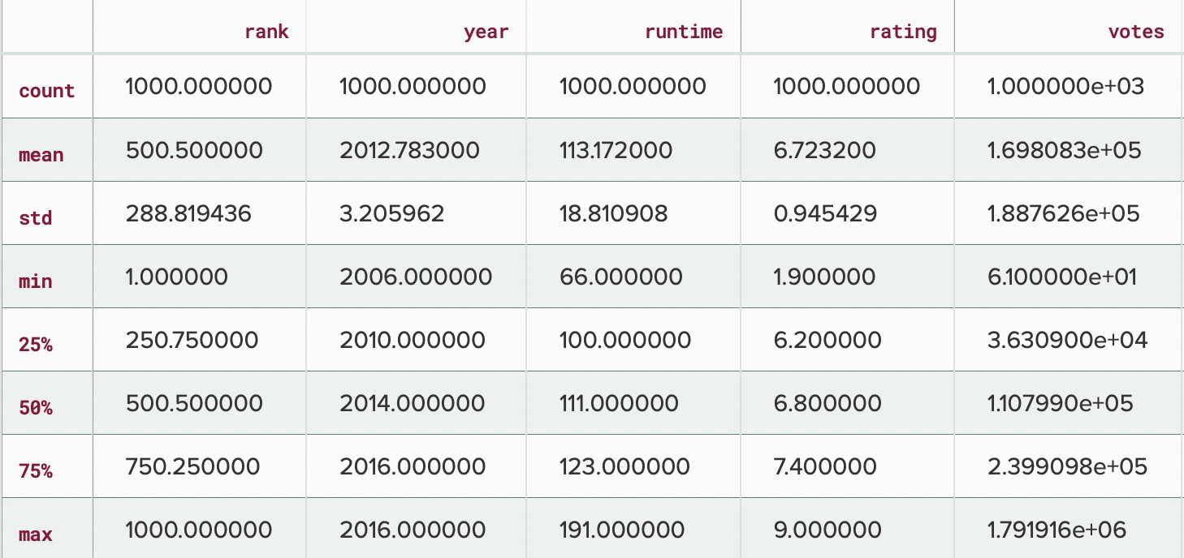

Understanding your variables
Official (Open)
Using describe() on an entire DataFrame we can get a summary of the distribution of continuous variables:
Command:
Output:
Notes:
Count automatically for you (only numerical values)

Slide 31
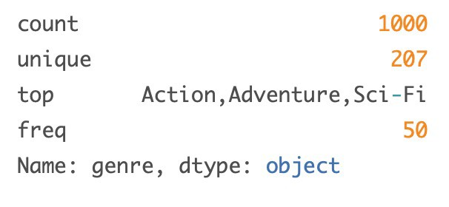

Understanding your variables
Official (Open)
.describe( ) can also be used on a categorical variable to get the count of rows, unique count of categories, top category, and freq of top category:
Command:
Output:
This tells us that the genre column has 207 unique values, the top value is Action/Adventure/Sci-Fi, which shows up 50 times (freq).
Notes:
Count -> rows

Slide 32
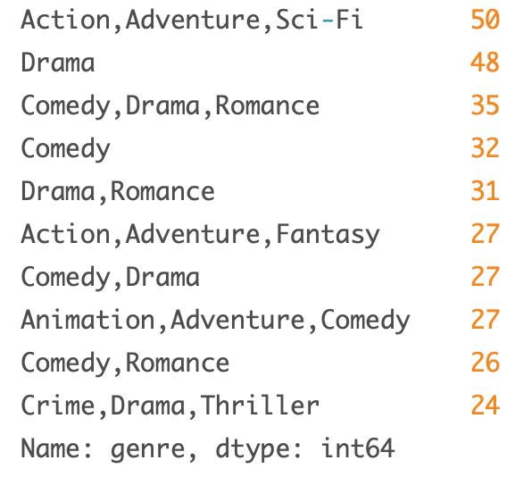

Understanding your variables
Official (Open)
.value_counts() can tell us the frequency of all values in a column: Command: Output:
Notes:
What do you mean by frequency? The number of times it shows up/appears??
Does the code mean:
From the movies dataframe, get the number of times the “genre” had showed up and return the first 10 rows?

Slide 33
Dataframe extraction – By column
Official (Open)
You already saw how to extract a column using square brackets like this:
This will return a Series. Command:
Output:

Slide 34

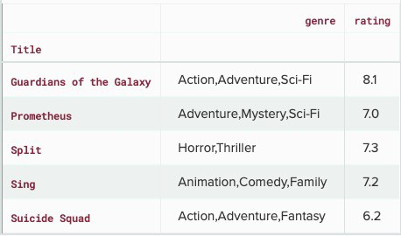
DataFram extraction – By column
Official (Open)
To extract a column as a DataFrame, you need to pass a list of column names. Command:
Output:
Notes:
More than 1 column, use two [ ]

Slide 35
Dataframe extraction – By row
Official (Open)
For rows, we have two options:
.loc – locates by name
.iloc – locates by numerical index Command:
Output:

Slide 36


Dataframe extraction – By row
Official (Open)
On the other hand, with iloc we give it the numerical index of the row: Command:
Output:

Slide 37
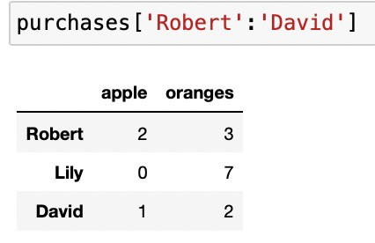
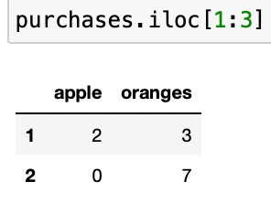
Dataframe extraction – Multiple rows
Official (Open)
One important distinction between using .loc and .iloc to select multiple rows is:
.loc includes ’David’ in the result,
.iloc excludes row 3 in the result.
Command: Output:
Command: Output:
Notes:
If want to include 3, need to put [1:4] -> add 1 if you want to include
Works differently from string

Slide 38

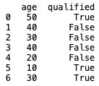
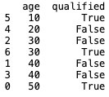
Sort values
Official (Open)
We can use the sort_values() method to sort the DataFrame by the specified label. Command: Output:
Notes:
Sort according to age

Slide 39
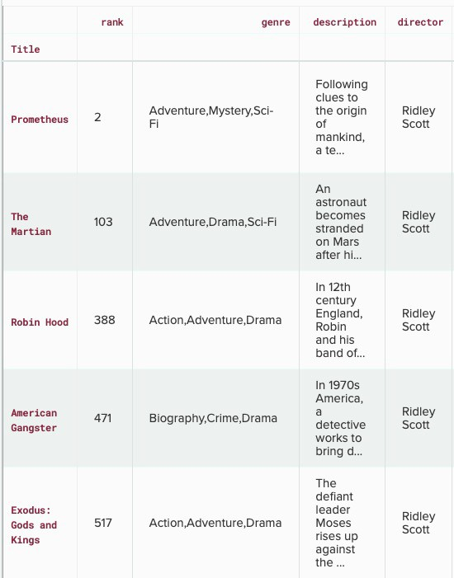
Conditional selections
Official (Open)
Command:
Output:
You can get used to looking at these conditionals by reading it like:
Select movies_df where movies_df director equals Ridley Scott.
Notes:
Get the director who Is Ridley Scott

Slide 40
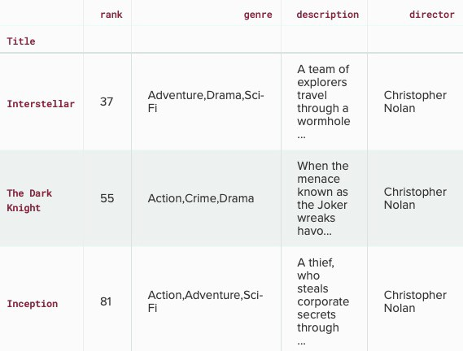
Conditional selections – numerical values
Official (Open)
Let's look at conditional selections using numerical values by filtering the DataFrame by ratings:
Command:
Output:
Notes:
If the rating column is more than or equal to 8.6, show the first 3 rows that satisfy the operations

Slide 41
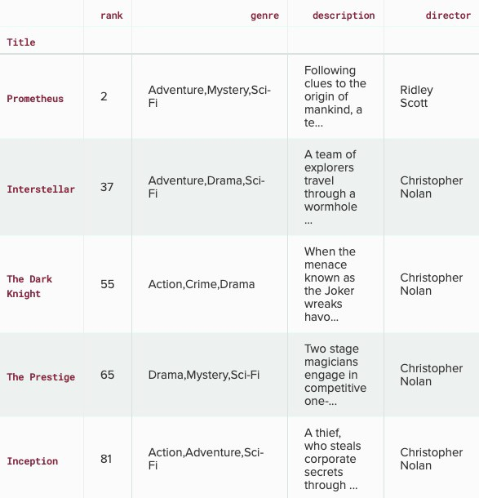
Conditional selections – logical operators
Official (Open)
We can make some richer conditionals by using logical operators | for "or" and & for "and".
Command:
Output:
Notes:
Select movies_df where movies_df director is equal to Christopher Nolan
OR
movies_df director is equal to Ridley Scott
Then show ALL the data regarding to the conditional statement

Slide 42
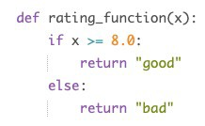
Applying functions
Official (Open)
An efficient alternative is to apply() a function to the dataset. For example, we could use a function to convert movies with an 8.0 or greater to a string value of "good" and the rest to "bad" and use this transformed values to create a new column.
First we would create a function that, when given a rating, determines if it's good or bad:
Notes:
Declare a function, if x is more than or equal to 8, it will display “good” or else it will display “bad”

Slide 43

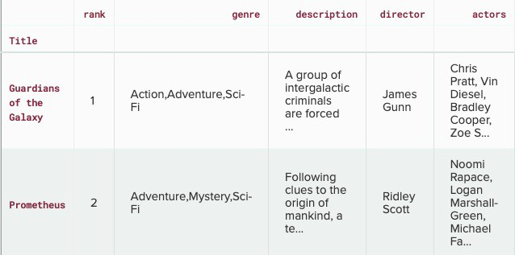
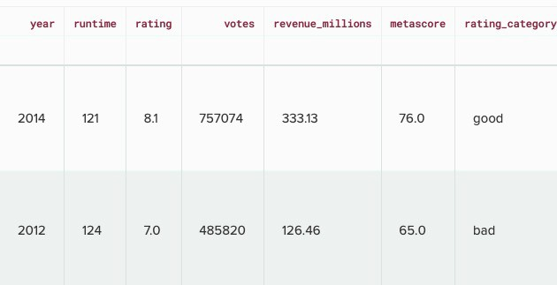
Applying functions
Official (Open)
Now we want to send the entire rating column through this function, which is what
apply() does:
Command:
Output:
Notes:
Get the rating column and use the rating_fuction to apply it to new column called rating_category so it will show either the rating is good or bad
Apply some functions in rating column

Slide 44
Applying functions - lambda
Official (Open)
You can also use anonymous functions as well. This lambda function achieves the same result as rating_function:
Command:
Output:
Notes:
Another way of applying using lambda instead of using functions

Slide 45



Cleaning Strings
Official (Open)
To trim whitespace, we will make use of the .strip() method. Command:
Output:

Slide 46



Cleaning Strings – Splitting strings into 2 columns
Official (Open)
We need to pass in the expand=True argument, in order to instruct Pandas to split the values into separate items.
Command:
Output:
Notes:
Use .str whenever it is a string

Slide 47



Cleaning Strings – Replace Text in Strings
Official (Open)
To remove a given substring in a larger string, we can use the .replace() method. The method takes a string we want to replace and a string that we want to substitute with.
Command:
before
after
Output:
Notes:
Replacement of text

Slide 48



Cleaning Strings – change string case
Official (Open)
.upper() will convert a string to all upper case
.lower() will convert a string to all lower case
.title() will convert a string to title case
Command: Output:

Slide 49
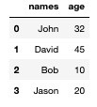

Cleaning Strings – start with xx
Official (Open)
Command:
Output:
Notes:
To get the name that start with “J”

Slide 50
Plotting
Official (Open)
Another great thing about pandas is that it integrates with Matplotlib, so you get the ability to plot directly off DataFrames and Series.
Before getting started, we need to install Matplotlib:
pip install matplotlib
Then, we need to import Matplotlib:
import matplotlib.pyplot as plt
Notes:
When you want to plot a graph such as bar chart or line chart

Slide 51

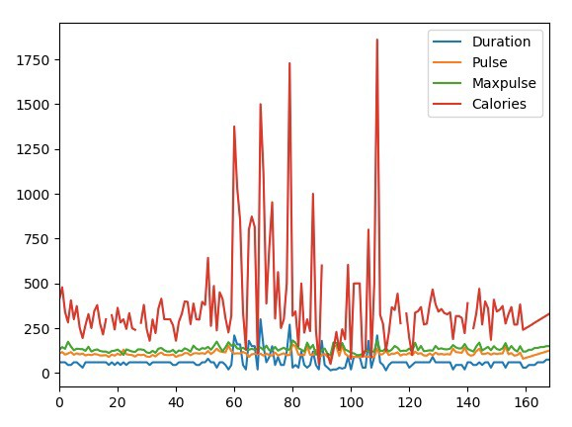
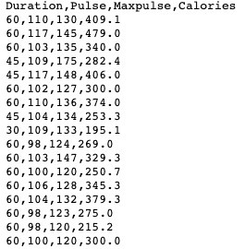
Line chart
Official (Open)
Command:
Output:
How data looks like:
Notes:
.plot() -> to plot the graph
.show() -> to show the graph

Slide 52
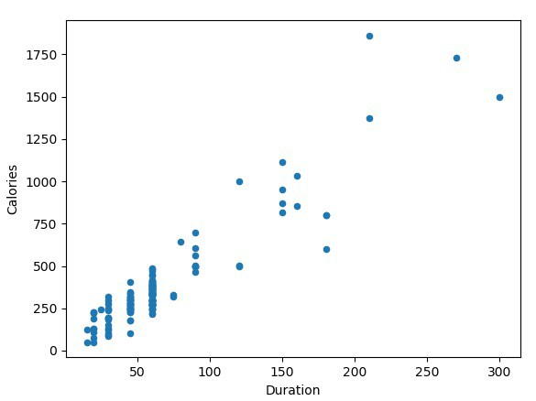

Scatter Plot
Official (Open)
Specify that you want a scatter plot with the kind argument (kind = 'scatter’) A scatter plot needs an x- and a y-axis.
In the example below we will use "Duration" for the x-axis and "Calories" for the y- axis. Include the x and y arguments like this: x = 'Duration', y = 'Calories'
Notes:
Plot the graph as “scatter” with x-axis being “duration”, y-axis being “calories”.
Then show() the graph
To show the r/s between the 2 datas (duration and calories)

Slide 53
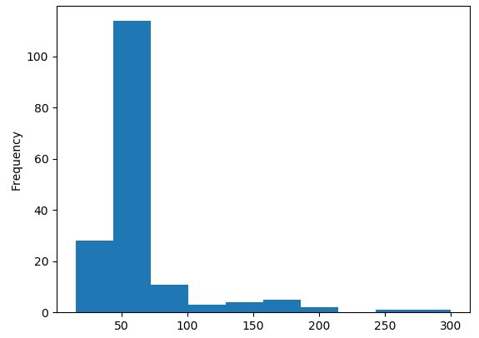

Histogram
Official (Open)
Use the kind argument to specify that you want a histogram (kind = 'hist’)
A histogram needs only one column. A histogram shows us the frequency of each interval, e.g. how many workouts lasted between 50 and 60 minutes?
In the example below we will use the "Duration" column to create the histogram:
Notes:
Histogram usually only takes one series to get the distribution of data

